Slide 2
Working with vulnerable workers: the psychological cost of precarious work in Australia
Sherry Huang
George Robertson
National Union of Workers

Slide 3
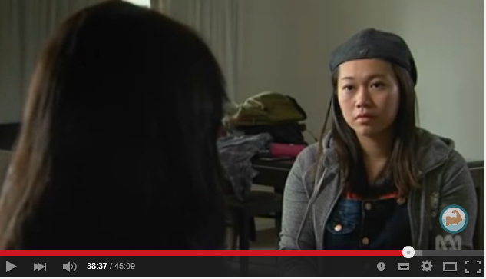
Heading 60pt Arial Regular
Bullet point 40pt Arial Regular
Second bullet point 40pt Arial Regular
Third bullet point 40pt Arial Regular
Fourth bullet point 40pt Arial Regular
Fifth bullet point 40pt Arial Regular
Sixth bullet point 40pt Arial Regular

Slide 4
Temporary Migrant Workers in Australia
1.2 million TMW in Australia = 10% of Australian workforce.
Including 250,000 Work & Holiday makers (417 & 462) per year
Most TMW are precariously employed by labour hire contractors
Most work on fruit & vegetable farms, in the meat & poultry industry at some stage during their stay

Slide 5
Psychological Hazards
Bullying & Discrimination
Sexual Harassment
Fatigue (long hours, repetitive work)
Fear

Slide 6
What has created this crisis?
Host employers using labour hire contractors to deliberately avoid responsibility for workplace conditions
Dodgy labour hire contractors – non compliance is part of their business model
Workers’ dependency on labour hire contractors for job, housing, transport, visa, often in isolated rural & regional areas.
Workers limited knowledge of labour and OHS rights & hostility of employers to enforcement of those rights
= Makes workers vulnerable, creates conditions for exploitation and enhances exposure to psychological hazards

Slide 7
How do we start to solve the crisis?
Labour hire licensing & regulation
Mandatory inductions for TMW on arrival in Australia
Worksafe
Enforcement
Code of practice

